Slide 1
CS7015 (Deep Learning) : Lecture 2
McCulloch Pitts Neuron, Thresholding Logic, Perceptrons, Perceptron Learning Algorithm and Convergence, Multilayer Perceptrons (MLPs), Representation Power of MLPs
Mitesh M. Khapra
Department of Computer Science and Engineering Indian Institute of Technology Madras

Slide 2
Biological Neurons
The most fundamental unit of a deep neural network is called an artificial neuron
Why is it called a neuron ? Where does the inspiration come from ?
The inspiration comes from biology (more specifically, from the brain)
biological neurons = neural cells = neural processing units
We will first see what a biological neuron looks like ...
y
σ
w₁ w₂ w₃
x₁ x₂ x₃
Artificial Neuron
2

Slide 3
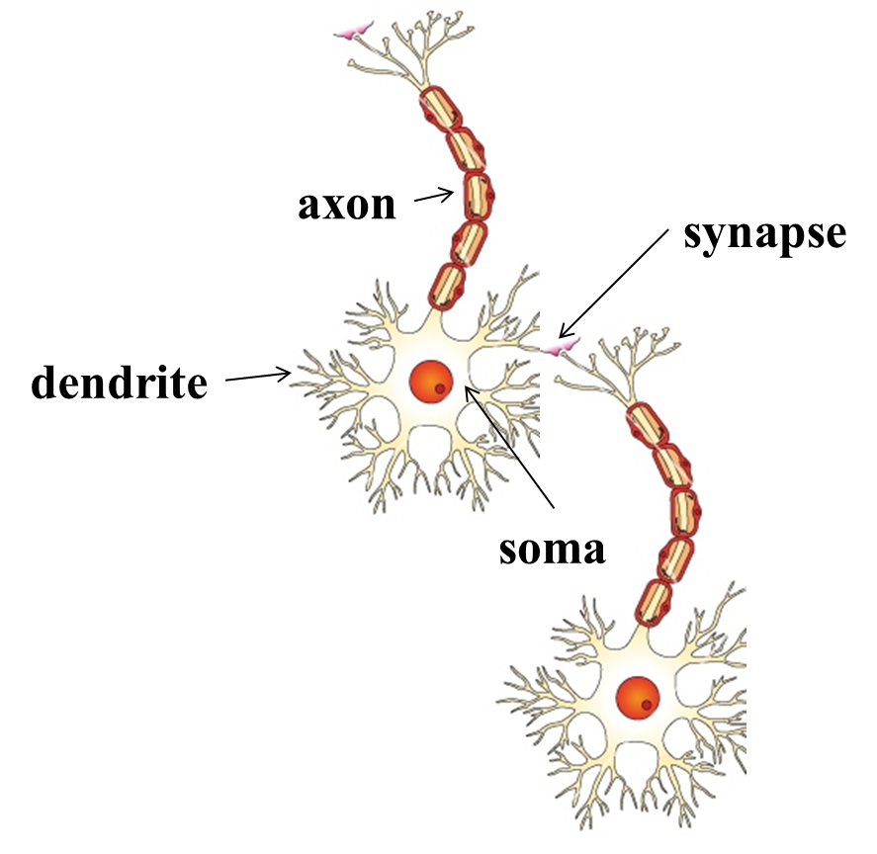
dendrite: receives signals from other neurons
synapse: point of connection to other neurons
soma: processes the information
axon: transmits the output of this neuron
Biological Neurons∗
3

Slide 4
Module 2.2: McCulloch Pitts Neuron

Slide 5
McCulloch (neuroscientist) and Pitts (logician) proposed a highly simplified computational model of the neuron (1943)
g aggregates the inputs and the function f takes a decision based on this aggregation
The inputs can be excitatory or inhibitory
y = 0 if any x_{i} is inhibitory, else
y ∈ {0, 1}
f
g
x₁ x₂
.. ..
x_{n} ∈ {0, 1}
n
Σ
g(x , x , ..., x ) = g(x) = x
1 2 n i
i=1
y = f (g(x)) = 1 if g(x) ≥ θ
= 0 if g(x) < θ
θ is called the thresholding parameter
This is called Thresholding Logic
11

Slide 6
Let us implement some boolean functions using this McCulloch Pitts (MP) neuron ...

Slide 7






y ∈ {0, 1}
y ∈ {0, 1}
y ∈ {0, 1}
θ
3
1
x₁ x₂ x₃
A McCulloch Pitts unit
x₁ x₂ x₃
AND function
x₁ x₂ x₃
OR function
y ∈ {0, 1}
y ∈ {0, 1}
y ∈ {0, 1}
1
0
0
x₁
x₂
x₁
x₂
x₁
NOT function
x₁ AND !x₂∗
NOR function
∗circle at the end indicates inhibitory input: if any inhibitory input is 1 the output will be 0
13

Slide 8
Can any boolean function be represented using a McCulloch Pitts unit ?
Before answering this question let us first see the geometric interpretation of a MP unit
...
14

Slide 9

y ∈ {0, 1}
A single MP neuron splits the input points (4 points for 2 binary inputs) into two halves
Σ
1
Points lying on or above the line and points lying below this line
n i=1
x_{i} − θ = 0
x₁ x₂
In other words, all inputs which produce an output
Σ
OR function
0 will be on one side (
n i=1
x_{i} < θ) of the line and
Σ
x + x =
2
i=1
x_{i} ≥ 1
all inputs which produce an output 1 will lie on the
1 2
Σ
other side (
n i=1
x_{i} ≥ θ) of this line
x₂
Let us convince ourselves about this with a few
(0, 1)
(1, 1)
more examples (if it is not already clear from the math)
x₁ + x₂ = θ = 1
(0, 0)
(1, 0)
x₁
15

Slide 10
y ∈ {0, 1}
y ∈ {0, 1}
2
0
x₁ x₂
x₁ x₂
Tautology (always ON)
AND function
Σ
x + x =
2
i=1
x_{i} ≥ 2
1 2
x₂
x₂
(0, 1)
(1, 1)
(0, 1)
(1, 1)
x₁ + x₂ = θ = 0
x₁ + x₂ = θ = 2
(0, 0)
(1, 0)
x₁
(0, 0)
(1, 0)
x₁
16

Slide 11
y ∈ {0, 1}
What if we have more than 2 inputs?
Well, instead of a line we will have a plane
For the OR function, we want a plane such that the point (0,0,0) lies on one side and the remaining 7 points lie on the other side of the plane
1
OR
x₁ x₂ x₃ x₂
(0, 1, 0)
(1, 1, 0)
(0, 1, 1)
(1, 1, 1)x₁ + x₂ + x₃ = θ = 1
(0, 0, 0)
(1, 0, 0) ^{x1}
(0, 0, 1)
(1, 0, 1)
x₃
17

Slide 12
The story so far ...
A single McCulloch Pitts Neuron can be used to represent boolean functions which are linearly separable
Linear separability (for boolean functions) : There exists a line (plane) such that all in- puts which produce a 1 lie on one side of the line (plane) and all inputs which produce a 0 lie on other side of the line (plane)
18

Slide 13
Module 2.3: Perceptron

Slide 14
The story ahead ...
What about non-boolean (say, real) inputs ?
Do we always need to hand code the threshold ?
Are all inputs equal ? What if we want to assign more weight (importance) to some inputs ?
What about functions which are not linearly separable ?
20

Slide 15
y
Frank Rosenblatt, an American psychologist, pro- posed the classical perceptron model (1958)
A more general computational model than McCul- loch–Pitts neurons
Main differences: Introduction of numerical weights for inputs and a mechanism for learning these weights
Inputs are no longer limited to boolean values
Refined and carefully analyzed by Minsky and Pa- pert (1969) - their model is referred to as the per- ceptron model here
w₁
w₂
.. ..
w_{n}
x₁ x₂
..
..
x_{n}
21

Slide 16
y
n
Σ
y = 1 if w ∗ x ≥ θ
i i
i=1
n
Σ
= 0 if w ∗ x < θ
i i
i=1
w₀ = −θ
x₀ = 1
w₁ w₂
.. ..
w_{n}
Rewriting the above,
x₁ x₂ ..
..
x_{n}
A more accepted convention,
n
n
Σ
Σ
y = 1 if w ∗ x − θ ≥ 0
i i
y = 1 if w_{i} ∗ x_{i} ≥ 0
i=1
n
i=0
Σ
n
= 0 if w ∗ x − θ < 0
Σ
i i
= 0 if w ∗ x < 0
i=1
i i
i=0
where,
x₀ = 1 and w₀ = −θ
22

Slide 17
We will now try to answer the following questions:
Why are we trying to implement boolean functions?
Why do we need weights ?
Why is w₀ = −θ called the bias ?

Slide 18
y
Consider the task of predicting whether we would like a movie or not
Suppose, we base our decision on 3 inputs (binary, for sim- plicity)
Based on our past viewing experience (data), we may give a high weight to isDirectorNolan as compared to the other inputs
Specifically, even if the actor is not Matt Damon and the genre is not thriller we would still want to cross the threshold θ by assigning a high weight to isDirectorNolan
w₀ = −θ
x₀ = 1
w₁
w₂ w₃
x₁
x₂
x₃
x₁ = isActorDamon x₂ = isGenreThriller x₃ = isDirectorNolan
24

Slide 19
w₀ is called the bias as it represents the prior (prejudice)
A movie buff may have a very low threshold and may watch any movie irrespective of the genre, actor, director [θ = 0]
On the other hand, a selective viewer may only watch thrillers starring Matt Damon and directed by Nolan [θ = 3]
The weights (w₁, w₂, ..., w_{n}) and the bias (w₀) will depend on the data (viewer history in this case)
y
w₀ = −θ
x₀ = 1
w₁
w₂ w₃
x₁
x₂
x₃
x₁ = isActorDamon x₂ = isGenreThriller x₃ = isDirectorNolan
24

Slide 20
What kind of functions can be implemented using the perceptron? Any difference from McCulloch Pitts neurons?

Slide 21
McCulloch Pitts Neuron
(assuming no inhibitory inputs)
From the equations it should be clear that even a perceptron separates the input space into two halves
All inputs which produce a 1 lie on one side and all inputs which produce a 0 lie on the other side
In other words, a single perceptron can only be used to implement linearly separable functions
Then what is the difference? The weights (includ- ing threshold) can be learned and the inputs can be real valued
We will first revisit some boolean functions and then see the perceptron learning algorithm (for learning weights)
n
Σ
y = 1 if x ≥ 0
i
i=0
n
Σ
= 0 if x < 0
i
i=0
Perceptron
n
Σ
y = 1 if w ∗ x ≥ 0
i i
i=0
n
Σ
= 0 if w ∗ x < 0
i i
i=0
26

Slide 22
x₁ | x₂ OR
0 | 0 0 | i=1
1 | 0 1 | i=1
0 | 1 1 | i=1
x₂
w₀ + ^{Σ2} w_{i}x_{i} < 0
w₀ + ^{Σ2} w_{i}x_{i} ≥ 0
(0, 1)
(1, 1)
Σ
w +
2
w_{i}x_{i} ≥ 0
0
Σ
1 1 1 w +
2
w x ≥ 0
−1 + 1.1x₁ + 1.1x₂ = 0
0 i i
i=1
w₀ + w₁ · 0 + w₂ · 0 < 0 =⇒ w₀ < 0
w₀ + w₁ · 0 + w₂ · 1 ≥ 0 =⇒ w₂ ≥ −w₀
w₀ + w₁ · 1 + w₂ · 0 ≥ 0 =⇒ w₁ ≥ −w₀
w₀ + w₁ · 1 + w₂ · 1 ≥ 0 =⇒ w₁ + w₂ ≥ −w₀
One possible solution to this set of inequalities is
(0, 0)
(1, 0)
x₁
Note that we can come up with a similar set of inequalities and find the value of θ for a McCul- loch Pitts neuron also (Try it!)
w₀ = −1, w₁ = 1.1, , w₂ = 1.1 (and various
other solutions are possible)

Slide 23
Module 2.5: Perceptron Learning Algorithm

Slide 24
y
Let us reconsider our problem of deciding whether to watch a movie or not
Suppose we are given a list of m movies and a la- bel (class) associated with each movie indicating whether the user liked this movie or not : binary decision
w₀ = −θ
x₀ = 1
w₁ w₂
.. ..
w_{n}
Further, suppose we represent each movie with n
features (some boolean, some real valued)
We will assume that the data is linearly separable and we want a perceptron to learn how to make this decision
In other words, we want the perceptron to find the equation of this separating plane (or find the val- ues of w₀, w₁, w₂, .., w_{m})
x₁ x₂ .. .. x_{n}
x₁ = isActorDamon x₂ = isGenreThriller x₃ = isDirectorNolan
x₄ = imdbRating(scaled to 0 to 1)
... ...
x_{n} = criticsRating(scaled to 0 to 1)
33

Slide 25
Algorithm: Perceptron Learning Algorithm
Why would this work ?
P ← inputs
with with
label 1;
label 0;
N ← inputs
Initialize w randomly;
while !convergence do
Pick random x ∈ P ∪ N ;
Σ
if x ∈ P and
n i=0
w_{i} ∗ x_{i} < 0 then
w = w + x ;
end
if x ∈ N and
w = w − x ;
Σ
n i=0
w_{i} ∗ x_{i} ≥ 0 then
end end
//the algorithm converges when all the inputs are classified correctly
34

Slide 26
Consider two vectors w and x
We are interested in finding the line w^{T}x = 0 which divides the input space into two halves
Every point (x) on this line satisfies the
w = [w₀, w₁, w₂, ..., w_{n}]
x = [1, x₁, x₂, ..., x_{n}]
n
Σ
T
T
equation w x = 0
w · x = w x = w ∗ x
i i
What can you tell about the angle (α) between w and any point (x) which lies on this line ?
i=0
We can thus rewrite the perceptron rule as
The angle is 90° (∵ cosα =
w^{T} x
= 0)
y = 1 if w x ≥ 0
= 0 if w^{T}x < 0
||w||||x||
T
Since the vector w is perpendicular to every point on the line it is actually per- pendicular to the line itself
35

Slide 27
How many boolean functions can you design from 2 inputs ?
Let us begin with some easy ones which you already know ..
^{x}1 | ^{x}2 | ^{f}1 | ^{f}2 | ^{f}3 | ^{f}4 | ^{f}5 | ^{f}6 | ^{f}7 | ^{f}8 | ^{f}9 | ^{f}10 | ^{f}11 | ^{f}12 | ^{f}13 | ^{f}14 | ^{f}15 | ^{f}16
0 | 0 | 0 | 0 | 0 | 0 | 0 | 0 | 0 | 0 | 1 | 1 | 1 | 1 | 1 | 1 | 1 | 1
0 | 1 | 0 | 0 | 0 | 0 | 1 | 1 | 1 | 1 | 0 | 0 | 0 | 0 | 1 | 1 | 1 | 1
1 | 0 | 0 | 0 | 1 | 1 | 0 | 0 | 1 | 1 | 0 | 0 | 1 | 1 | 0 | 0 | 1 | 1
1 | 1 | 0 | 1 | 0 | 1 | 0 | 1 | 0 | 1 | 0 | 1 | 0 | 1 | 0 | 1 | 0 | 1
Of these, how many are linearly separable ? (turns out all except XOR and !XOR - feel free to verify)
In general, how many boolean functions can you have for n inputs ? 2^{2n}
How many of these 2^{2n} functions are not linearly separable ? For the time being, it suffices to know that at least some of these may not be linearly inseparable (I encourage you to figure out the exact answer :-) )
54

Slide 28
Module 2.8: Representation Power of a Network of Perceptrons

Slide 29
For this discussion, we will assume True = +1 and False = -1
We consider 2 inputs and 4 perceptrons
Each input is connected to all the 4 per- ceptrons with specific weights
The bias (w₀) of each perceptron is -2 (i.e., each perceptron will fire only if the weighted sum of its input is ≥ 2)
Each of these perceptrons is connected to an output perceptron by weights (which need to be learned)
The output of this perceptron (y) is the out- put of this network
y
w₁
w₂ w₃ w₄
bias =-2
x₁
red edge indicates w = -1 blue edge indicates w = +1
x₂
57

Slide 30
Terminology:
This network contains 3 layers
The layer containing the inputs (x₁, x₂) is called the input layer
The middle layer containing the 4 perceptrons is called the hidden layer
The final layer containing one output neuron is called the output layer
The outputs of the 4 perceptrons in the hid- den layer are denoted by h₁, h₂, h₃, h₄
The red and blue edges are called layer 1 weights
y
w₁
w₂ w₃ w₄
h₂ h₃
h₁
h₄
bias =-2
x₂
x₁
red edge indicates w = -1 blue edge indicates w = +1
w1 , w 2 , w3 , w4 are called layer 2 weights
58

Slide 31
We claim that this network can be used to im- plement any boolean function (linearly separ- able or not) !
In other words, we can find w₁, w₂, w₃, w₄
such that the truth table of any boolean func-
y
w₁
w₂ w₃ w₄
h₂ h₃
-1,1 1,-1
tion can be represented by this network
Astonishing claim! Well, not really, if you un- derstand what is going on
Each perceptron in the middle layer fires only for a specific input (and no two perceptrons fire for the same input)
Let us see why this network works by taking an example of the XOR function
h
1
h₄
1,1
-1,-1
bias =-2
x₁
red edge indicates w = -1 blue edge indicates w = +1
x₂
59

Slide 32
Let w₀ be the bias output of the neuron (i.e.,
Σ
it will fire if
4
i=1
w_{i}h_{i} ≥ w₀)
y
Σ
4
x₁ x₂ XOR h₁ h₂ h₃ h₄ w_{i}h_{i}
i=1
0 | 0 | 0 | 1 | 0 | 0 | 0 | w₁
0 | 1 | 1 | 0 | 1 | 0 | 0 | w₂
w₁
w₂ w₃ w₄
h₂ h₃
-1,1 1,-1
h
1
h₄
1,1
1 0 1 0 0 1 0 w
3
-1,-1
1 1 0 0 0 0 1 w₄
This results in the following four conditions to
bias =-2
implement XOR: w₁ < w₀, w₂ ≥ w₀, w₃ ≥
x₁
red edge indicates w = -1 blue edge indicates w = +1
x₂
w₀, w₄ < w₀
Unlike before, there are no contradictions now and the system of inequalities can be satisfied
Essentially each w_{i} is now responsible for one of the 4 possible inputs and can be adjusted to get ₆₀ the desired output for that input

Slide 33
It should be clear that the same network can be used to represent the remaining 15 boolean functions also
Each boolean function will result in a dif- ferent set of non-contradicting inequalities
y
w₁
w₂ w₃ w₄
h₂ h₃
-1,1 1,-1
which can be satisfied by appropriately set- ting w₁, w₂, w₃, w₄
Try it!
h
1
h₄
1,1
-1,-1
bias =-2
x₁
red edge indicates w = -1 blue edge indicates w = +1
x₂
61

Slide 34
What if we have more than 3 inputs ?

Slide 35
Again each of the 8 perceptorns will fire only for one of the 8 inputs
Each of the 8 weights in the second layer is responsible for one of the 8 inputs and can be adjusted to produce the desired output for that input
y
w₁ w₂ w₃ w₄
w₅ w₆ w₇ w₈
bias =-3
x₁
x₂
x₃

Slide 36
What if we have n inputs ?

Slide 37
Theorem
Any boolean function of n inputs can be represented exactly by a network of perceptrons containing 1 hidden layer with 2^{n} perceptrons and one output layer containing 1 perceptron
65

Slide 38
Theorem
Any boolean function of n inputs can be represented exactly by a network of perceptrons containing 1 hidden layer with 2^{n} perceptrons and one output layer containing 1 perceptron
Proof (informal:) We just saw how to construct such a network
Note: A network of 2^{n} + 1 perceptrons is not necessary but sufficient. For example, we already saw how to represent AND function with just 1 perceptron
65

Slide 39
Theorem
Any boolean function of n inputs can be represented exactly by a network of perceptrons containing 1 hidden layer with 2^{n} perceptrons and one output layer containing 1 perceptron
Proof (informal:) We just saw how to construct such a network
Note: A network of 2^{n} + 1 perceptrons is not necessary but sufficient. For example, we already saw how to represent AND function with just 1 perceptron
Catch: As n increases the number of perceptrons in the hidden layers obviously increases exponentially
65

Slide 40
Again, why do we care about boolean functions ?
How does this help us with our original problem: which was to predict whether we like a movie or not?
66

Slide 41
The story so far ...
Networks of the form that we just saw (containing, an input, output and one or more hidden layers) are called Multilayer Perceptrons (MLP, in short)
More appropriate terminology would be“Multilayered Network of Perceptrons” but MLP is the more commonly used name
The theorem that we just saw gives us the representation power of a MLP with a single hidden layer
Specifically, it tells us that a MLP with a single hidden layer can represent any boolean function
68

